Slide 1
Allergen nasal provocation test as a outcome measure tool in immunotherapy of allergic rhinitis
Department of allergy and clinical immunology, Ajou university, Suwon, Korea
Yoo Seob Shin

Slide 2
Contents
Outcome measure tool in ITx.
The possibility of nasal allergen provocation test
as a outcome measure tool in ITx.

Slide 3
Unmet need
How can measure allergic status of patients after allergen ITx by objective methods ?
When do we stop allergen ITx ?

Slide 4
Current outcome measure (US)
Achievement of recommended maintenance dose of standardized allergens for patient treated with immunotherapy for at least 1 year
- Patient adherence to schedule
- Patient having bothersome large local or systemic reaction
- Patients with interruptions in therapy due to co-morbid conditions (ie, pregnancy)
- Too many antigens for intended number of vials
Routine periodic skin testing or in vitro IgE antibody testing of patients receiving immunotherapy is not recommended.
Ann Allergy Asthma Immunol. 2011;107:289 –300.
Ann Allergy Asthma Immunol. 2003;90(5):supl 1-40.

Slide 5
Current outcome measure (EAACI)
Unmet needs of allergen-specific immunotherapy
- Development of generally accepted primary outcome measures
(i.e. symptom medication scores)
- Biomarkers that may predict the outcome of treatment are needed.
To industry
- Both researchers and industry may profit from standard outcome measures.
Pediatric Allergy and Immunology 2012;23: 300–306

Slide 6
Which Outcome Measures are Useful in Monitoring SIT?
Primary end point
- the severity of symptoms and the need for medication
- daily basis diary
Secondary end point
- Quality of life or impact on work related ability
- Questionnaire
Others
- allergen provocation test
- specific IgG₄, ratio of IgE to IgG₄
- IgE binding capacity of the patient’s serum
- cytokine analysis, cell activation marker, cell proliferation assay
Immunol Allergy Clin North Am. 2011;31(2):289-309

Slide 7
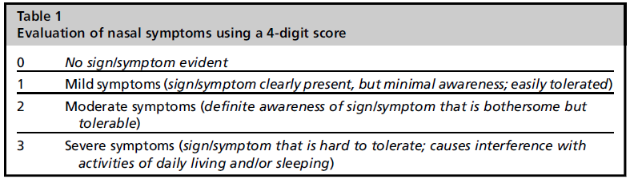
Patients’ self-rated diary
(symptoms and medication)
Patient-rated scores should be preferred as primary outcome parameters.
There are no symptoms scores validated for clinical trials on SIT.
For AR, rhinoconjunctivitis total symptom score (RTSS) is generally accepted. (range 0~18)
- congestion, sneezing, itching, secretion, itching of eye, ocular secretion (6x3=18)
Canonica GW (WAO task force) et al. Allergy 2007;62(3):317–24.
Immunol Allergy Clin North Am. 2011;31(2):289-309

Slide 8
Patients’ self-rated diary
(symptoms and medication)
Symptom scores always be combined with the concomitant medication scores to provide clinically more relevant information on.
- 1 point : topical and oral antihistamine
- 2 point : nasal corticosteroid
- 3 point : oral corticosteroid
No effect, improvement of <30%
Little effect, improvement of 30%–44%
Moderate effect, improvement of 45%–59%
Strong effect, improvement of >60%.
Malling HJ et al. Allergy 1998;53(5):461–72.

Slide 9
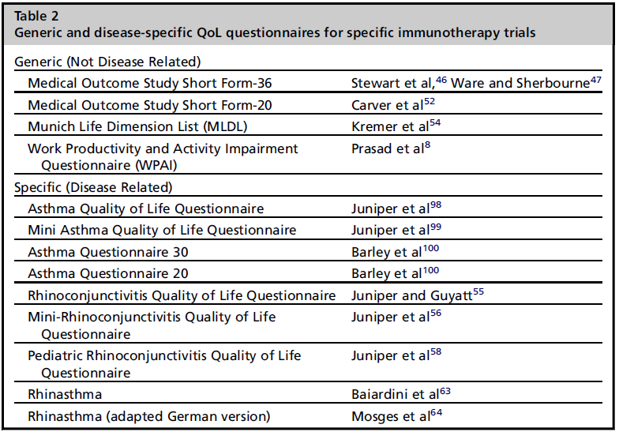
Health related quality of life
Assessing the HR-QoL is a valuable and sensitive tool for evaluating a therapeutic improvement of SIT as a secondary outcome.

Slide 10
Provocation test as surrogate marker
Provocation tests may be used as primary end points in early-stage, dose-ranging studies.
Nasal provocation test (NPT) is standardized and provides both high sensitivity and specificity.
In a controlled open trial, SCIT resulted in a 10-fold higher allergen concentration required to provoke a positive NPT result compared with pretreatment.
Commitee for medicinal products for human use (CHMP). London; 2008.
Keskin O et al. Pediatr Allergy Immunol 2006;17(6):396–407.

Slide 11
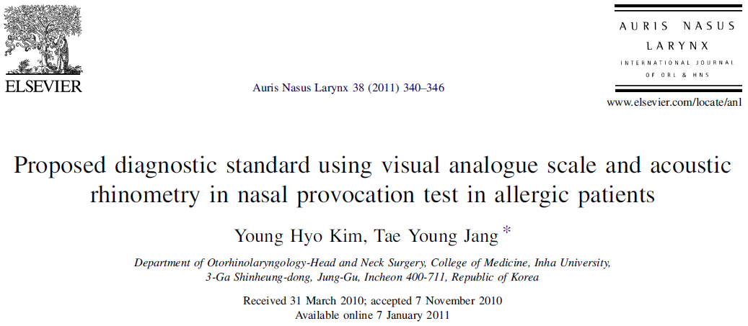
Kim et al. Auris nasus larynx 2011;340-46

Slide 12
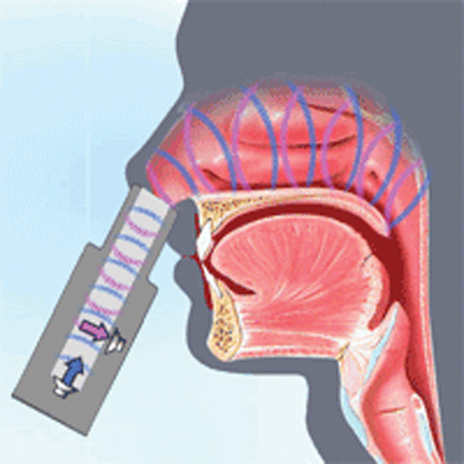
Acoustic rhinometry
Information about cross sectional area and nasal cavity volume by sound reflection
Advantages
- patients’ cooperation is not required
- take less time
- non-invasive
- quantitative analysis

Slide 13
Materials and methods
Positive : 208 AR patients who had clinical symptoms of AR and their MAST results were strongly positive (4+) for Der. P.
Control : 222 patients clinically diagnosed with non AR and whose MAST results were negative for HDM.
Exclusion
- nasal pathology such as chronic sinusitis or severe septal deviation
- patients less than 20 years old
- patients taking antihistamine or systemic steroid medication
- patients with asthma or aspirin sensitivity
- pregnant or lactating women
Kim et al. Auris nasus larynx 2011;340-46

Slide 14
Materials and methods
Baseline
Before
After
acoustic rhinometry
+ VAS (10cm)
for nasal obstruction, rhinorrhea and itching
acoustic rhinometry
+ VAS (10cm)
after 15 min of saline challenge
acoustic rhinometry
+ VAS (10cm)
after 15 min of HDM challenge
0.9% NaCl nasal challenge
1:10 diluted HDM
nasal challenge
Spray twice at both nostrils
with 40-50 μl

Slide 15
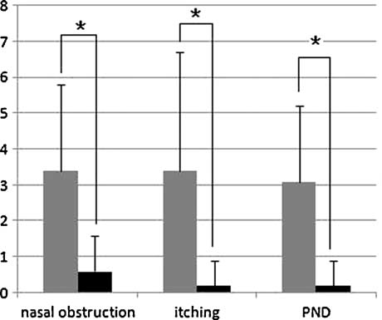
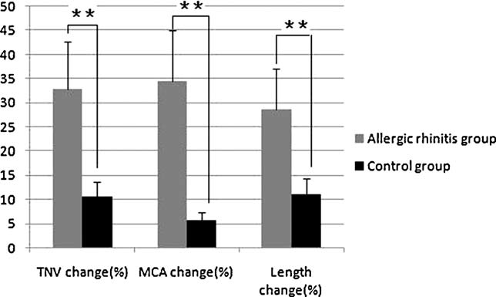
Results
Fig. The change of nasal obstruction, itching and PND in AR and control group
Fig. The change in TNV, MCA and length of MCA with HDM allergen challenge.

Slide 16
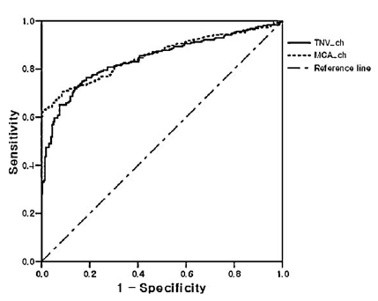
Results
Change of the TNV > 24.7%
: the sensitivity was 70.2%
: the specificity was 77.8%
Change of the MCA > 20%
: the sensitivity was 70.6%
: the specificity was 80.5%

Slide 17
Conclusions
The authors set the diagnostic criteria of nasal provocation as follows:
(1) symptom change: more than 2 points in the case of nasal obstruction and more than 1 point in the case of rhinorrhea or itching
(2) more than 24.5% of TNV change
(3) more than 20% of MCA change

Slide 18
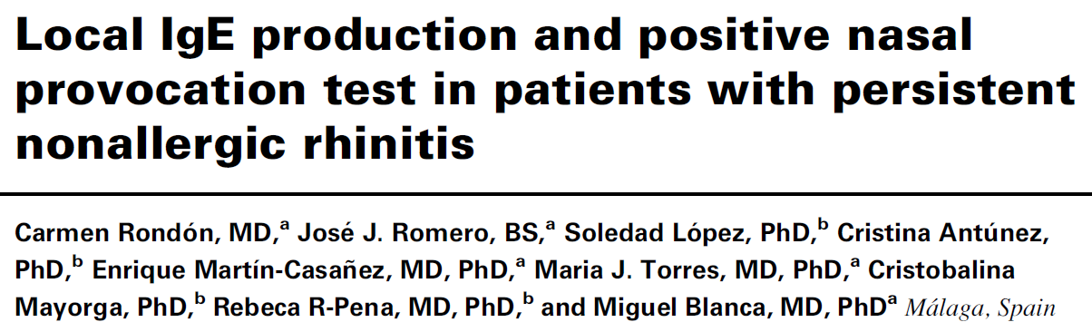

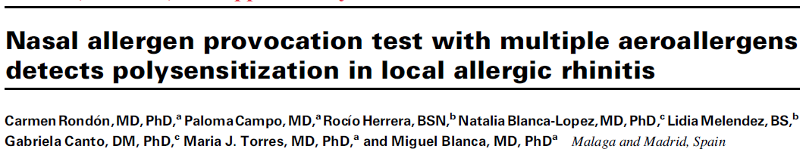
J Allergy Clin Immunol 2007;119:899-905.
Current Opinion in Allergy and Clinical Immunology 2010, 10:1–7.
J Allergy Clin Immunol 2011;128:1192-7.

Slide 19
NAPT in Blanca group
Exclusion criteria
- pregnant or breast-feeding women
- other immunologic diseases
- chronic rhinosinusitis
- nasal polyposis (CT scan)
- vasomotor rhinitis (clear rhinorrhea response to ipratropium bromide)
- respiratory tract infection in the previous 4 weeks
Avoidance
- systemic or nasal corticosteroids for 4 weeks
- systemic or nasal antihistamines for 2 weeks
- nasal vasoconstrictors for 1 week

Slide 20
NAPT in Blanca group
VAS
- obstruction, rhinorrhea, itching, sneezing, ocular symptoms
- 10cm scale
- total range 0-500
- measure at 15 minutes after each challenge
Acoustic rhinometry
- The mean value of the volume in the anterior nasal segment
(Volume 2-6 cm)
- measure at 15 minutes after the challenge

Slide 21
NAPT in Blanca group
Inclusion criteria
- at least 2 years history
- negative SPT, specific IgE and negative ID test to DP
Protocol
Baseline
Before
After
Positive response
Acoustic rhinometry
+ VAS
Acoustic rhinometry
+ VAS
Acoustic rhinometry
+ VAS
Subjective
- increase higher than 30%
in the total VAS
Objective
- decrease higher than 30%
in volume 2-6cm in acoustic
rhinometry compared with
baseline test
2 puff of saline
in each nostril
15 minutes later
2 puff of Der. P
(0.4, 1, 2, 4 μg/mL)
in each nostril
(0.05mL)

Slide 22
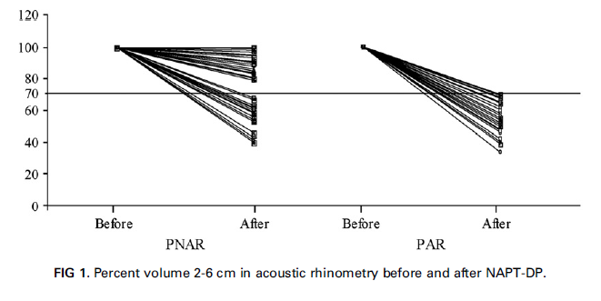
Results
In the PNAR group, 54% presented a positive response to NAPT-DP with an increase in the VAS and a decrease higher than 30% in the % Volume 2-6 cm.
100% of patients had an immediate response, and 37% a dual response.
54%
100%
Fig. Percent volume 2-6 cm in acoustic rhinometry before and after NAPT-DP.

